Slide 1
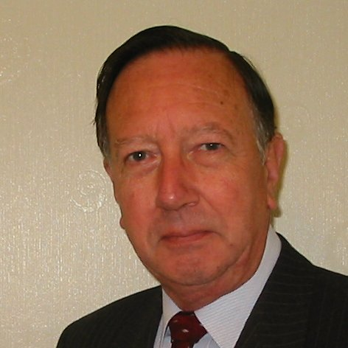
Welcome
These challenges were developed by Derrick Willer MBE and colleagues.
They are free to download and use in an education environment.
Please ensure that there is adult supervision, complete adherence to Health and Safety, and adequate PPE.
Derrick is a STEM Ambassador and volunteer Liaison Officer for Schools.
He has supported education in schools and colleges for over 30 years, initially as a Neighbourhood Engineer in the 1980’s, leading the local Year of Engineering Success campaign in 1996 and the Campaign to Promote Engineering from 1997 to 2004.
He was awarded an MBE for services to Education in 2018.

Slide 2
Guide
This activity is for pupils to discover the water cycle of evaporation and rain.
Mandatory close supervision by a competent adult
Risks
Item | Risk | Avoidance Action
Tools | Misuse, Injury | Close supervision
Glass | Breakage Injury | Close supervision. Clear up broken glass
Aggression between those present | Injury | Close supervision and immediate action to defuse aggression

Slide 3
Welcome
I very much hope that you will enjoy discovering about the water cycle on our planet

Slide 4
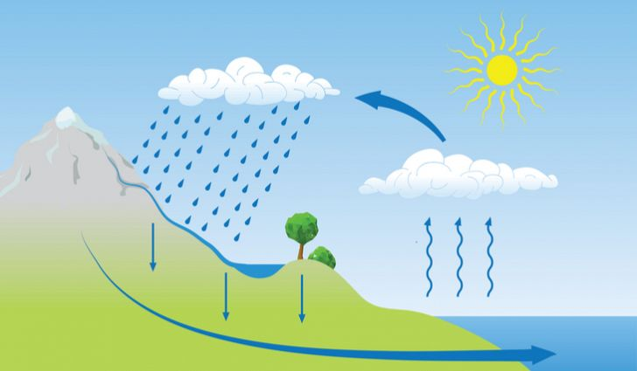
Precipitation
(Rain)
Let’s do an experiment
to show how it works
Evaporation
All known life requires water and all life on land depends on the Water Cycle
Click for next slide

Slide 5
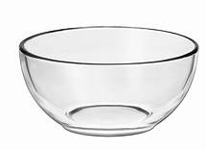
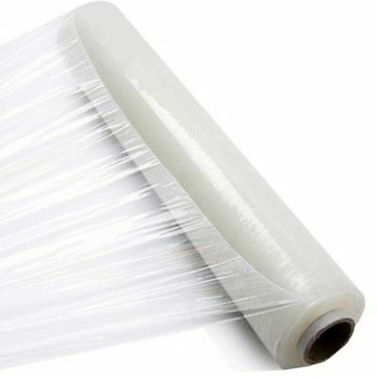
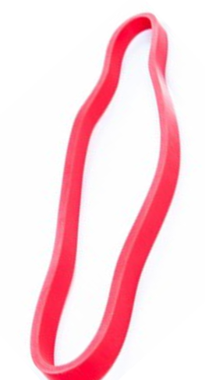
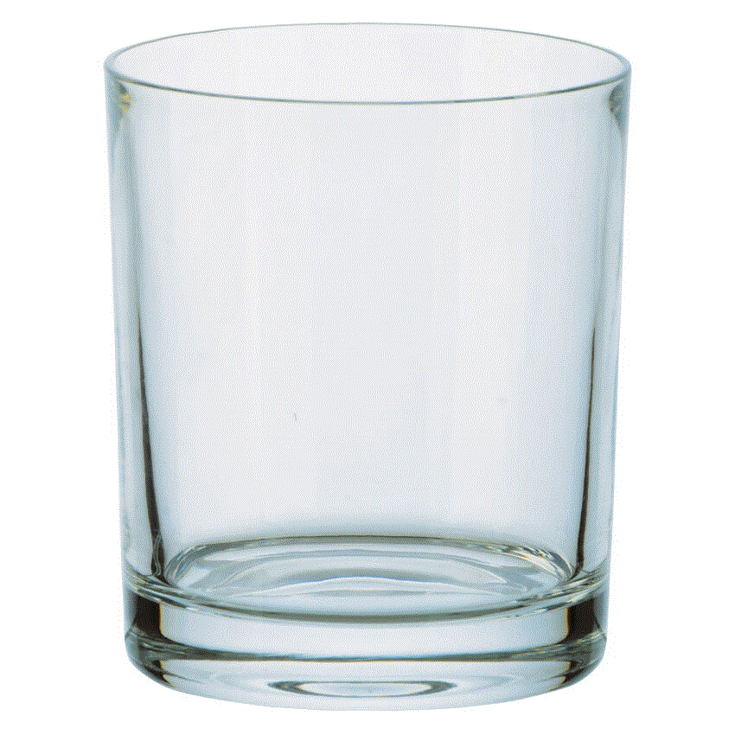
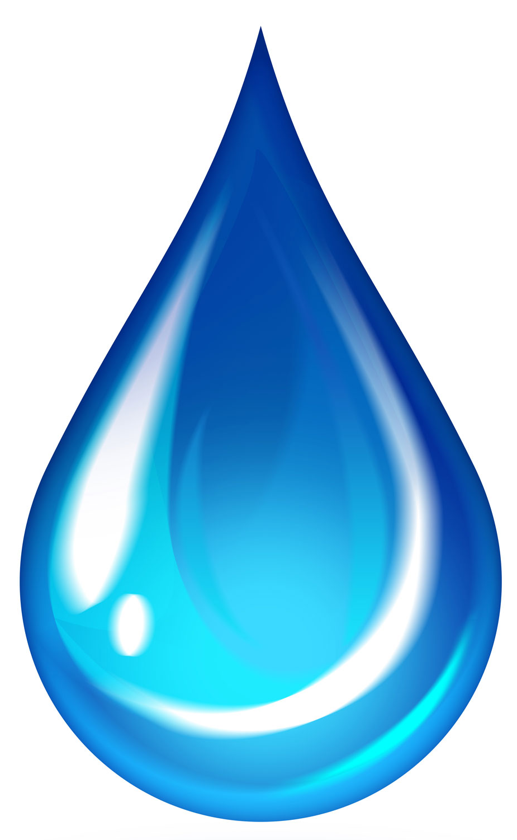
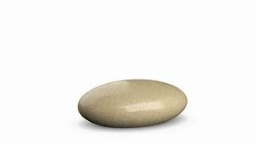
What you need:
A large bowl
A glass tumbler
Clingfilm
Rubber band
Small pebble
Water
The tumbler should be at least 1cm smaller than the bowl height
Click for next slide

Slide 6

What to do:
Fill the large bowl about 3cm deep with water
Put the glass tumbler into the water
Seal the top with clingfilm
Use the rubber band to secure
the clingfilm.
Place the pebble in the centre of the clingfilm to slightly weigh down the clingfilm over the glass tumbler.
Click for next slide

Slide 7
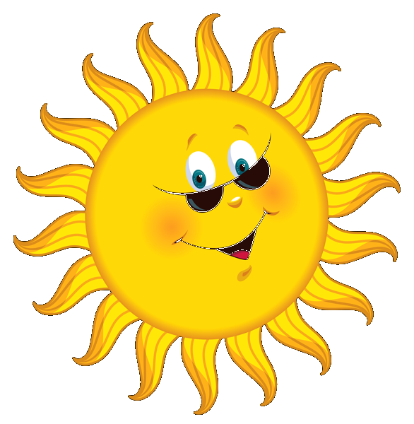

What to do:
Place the bowl close to the window on a sunny day.
After a few hours look at the bowl.
There may be water in the tumbler.
Click for next slide

Slide 8
Move the bowl away from the sunlight and look again after a few more hours.
Even more water will have condensed into the glass.
Some water droplets should be on the surface of the clingfilm.
And some water will be in the glass tumbler.
Water Level 2
Water Level 1
Click for next slide

Slide 9
Explanation:
When the sun was shining on the bowl the temperature inside the bowl increased.
So the water began to evaporate.
The clingfilm is in contact with the cooler air in the room.
When the water vapour touches the cold clingfilm it condenses back into liquid water.
The water runs down to the point where the pebble is and drops not the tumbler
Water Level 2
Water Level 1
Click for next slide

Slide 10
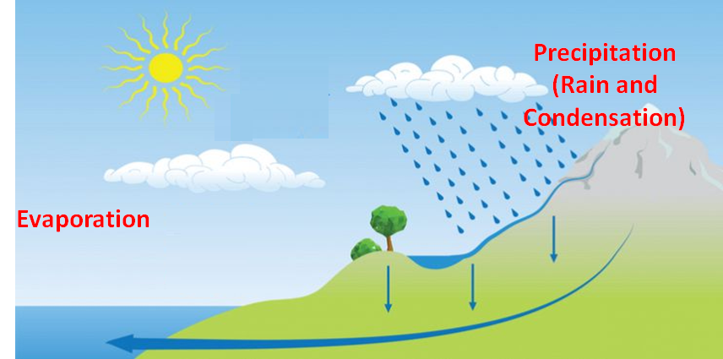
You have seen and now understand how the Water Cycle works.
Gravity returns the water to the sea
Click for next slide

Slide 11

Well Done
Click for next slide

