Slide 1
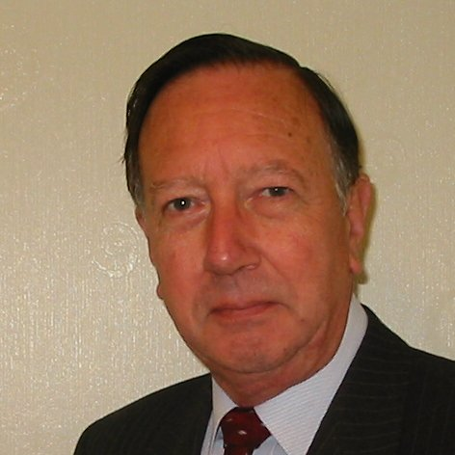
Welcome
These challenges were developed by Derrick Willer MBE and colleagues.
They are free to download and use in an education environment.
Please ensure that there is adult supervision, complete adherence to Health and Safety, and adequate PPE.
Derrick is a STEM Ambassador and volunteer Liaison Officer for Schools.
He has supported education in schools and colleges for over 30 years, initially as a Neighbourhood Engineer in the 1980’s, leading the local Year of Engineering Success campaign in 1996 and the Campaign to Promote Engineering from 1997 to 2004.
He was awarded an MBE for services to Education in 2018.

Slide 2
Guide
This activity is for pupils to make a thermometer.
Mandatory close supervision by a competent adult
Risks
Item | Risk | Avoidance Action
Tools | Misuse Injury | Close supervision
Alcohol | Injury | Close supervision. Do not allow pupils to drink. Water to rinse mouth and to drink
Liquids | Spillage | Close supervision. Sponge, mop and bucket to hand
Aggression between those present | Injury | Close supervision and immediate action to defuse aggression

Slide 3
Welcome
I very much hope that you will enjoy discovering how to make a thermometer

Slide 4
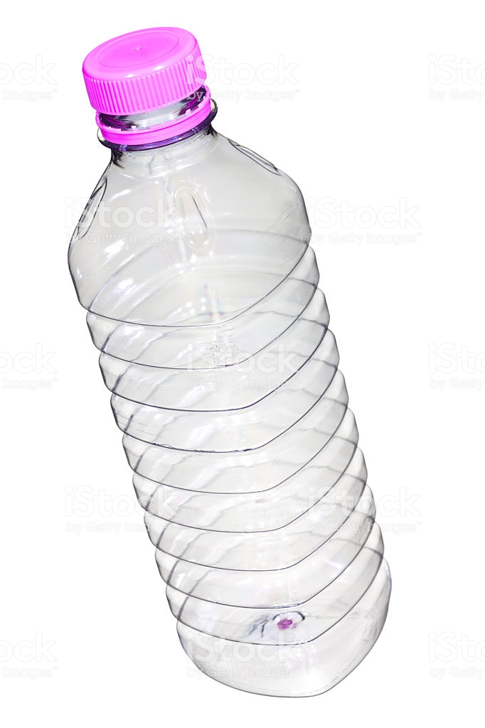
Make A Thermometer
20º
15º
10º
Make a Thermometer out of a dink bottle, straw, alcohol and water
Click for next slide

Slide 5
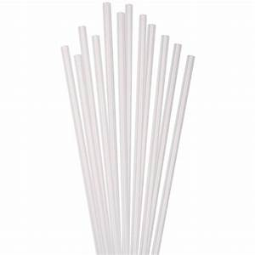
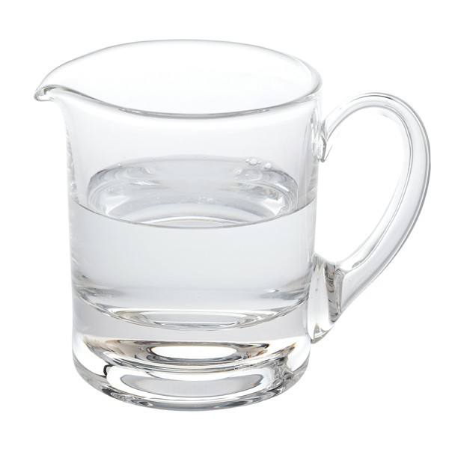
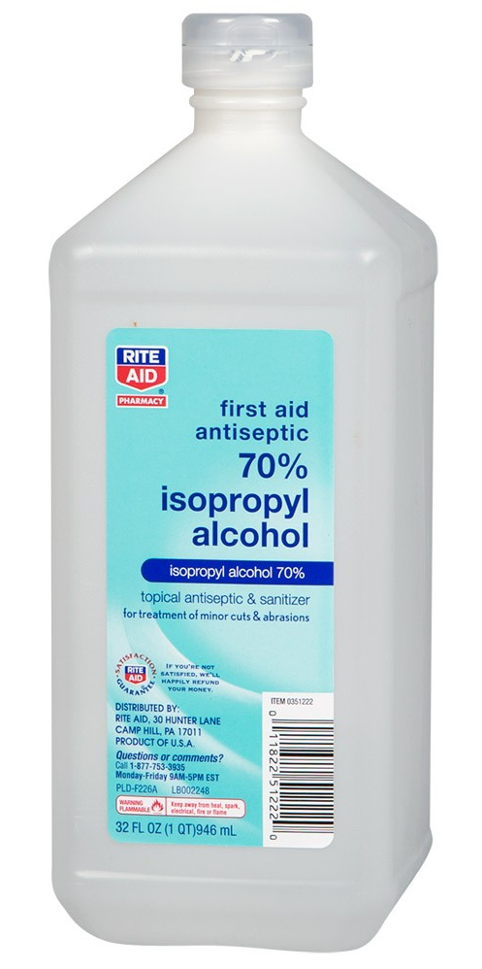
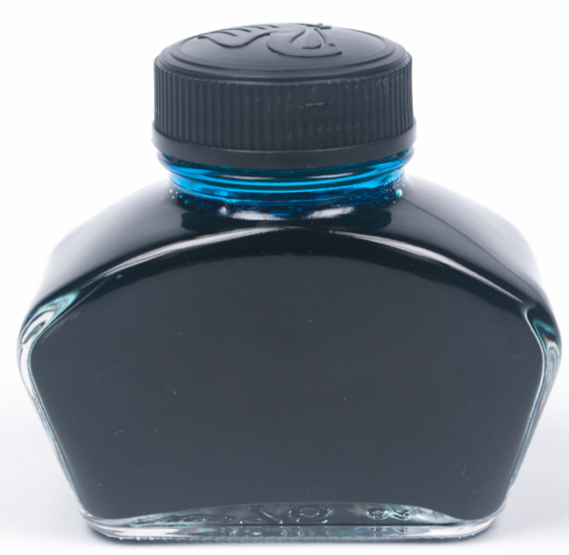
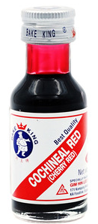
2
You Need:
Plastic Bottle and Top
White Straw
Drill and 6mm Dia Bit
Thermometer
Water
Medical Alcohol (Optional)
Colour (e.g. ink, cochineal)
Card
Cut to
5cm x 15cm
Click for next slide

Slide 6
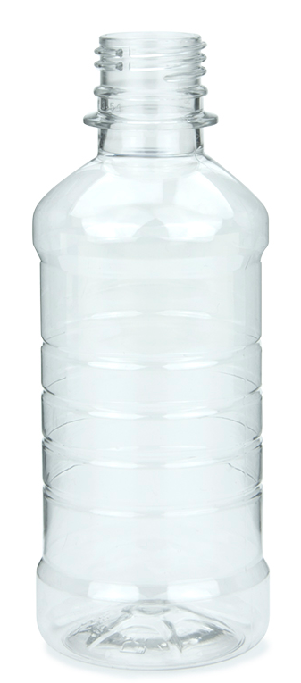

Drill a hole in
the bottle top.
Put the straw
through the hole.
Fill the bottle with
half water and half alcohol and a few drops of colour
Assemble the top with straw to the bottle
Glue the card to the straw
To the top
So you can see the colour through the bottle
Click for next slide

Slide 7
Leave your thermometers in the room for ten minutes
Check the temperature on the digital thermometer – e.g. 21^{O}C
Mark the level as 21 on the card
Leave your thermometers in a refrigerator for ten minutes
Check the temperature on the digital thermometer – e.g. 5^{O}C
Mark the level as on the card
Leave your thermometers outside for ten minutes
Check the temperature on the digital thermometer – e.g. 15^{O}C
Mark the level as on the card
20ºC
15ºC
5ºC
Click for next slide

Slide 8
Now you have three “Calibrated” temperatures on your card.
e.g.
20ºC
15ºC
5ºC
Now judge the temperatures between the known ones and mark the card with equal spaces.
You can extend the marks above and below the marked temperatures.
20
15
10
5
Click for next slide

Slide 9
20
You can now use your thermometer to measure different temperatures
Why not use it to record the daily temperatures at mi-day and bed-time and put them on a graph?
Perhaps you can do this throughout the year
to find out how temperatures change from
autumn, through winter and spring to summer
15
25
20
15
10
5
0
10
Mid-Day
Bedtime
5
Mon Tue Wed Thu Fri Sat Sun
Click for next slide

Slide 10

Well Done
Click for next slide

