Slide 1
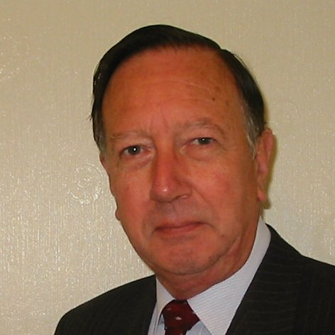
Welcome
These challenges were developed by Derrick Willer MBE and colleagues.
They are free to download and use in an education environment.
Please ensure that there is adult supervision, complete adherence to Health and Safety, and adequate PPE.
Derrick is a STEM Ambassador and volunteer Liaison Officer for Schools.
He has supported education in schools and colleges for over 30 years, initially as a Neighbourhood Engineer in the 1980’s, leading the local Year of Engineering Success campaign in 1996 and the Campaign to Promote Engineering from 1997 to 2004.
He was awarded an MBE for services to Education in 2018.

Slide 2
Guide
This activity is for pupils to various logic and maths activities to solve.
Mandatory close supervision by a competent adult
Risks
Item | Risk | Avoidance Action
Aggression between those present | Injury | Close supervision and immediate action to defuse aggression

Slide 3
Welcome
I very much hope that you will enjoy this fun logic activity and learn new things

Slide 4
The £10 Challenge
A man has £10 in his pocket.
On his way to work he buys a newspaper for £1 at 8am
He arrives at work just before 9am and buys a coffee for £1
He buys a coffee every hour until he leaves work at 5:30pm
At the station there is a newsagent who sells two evening papers
The Evening News and the Standard
Which newspaper does the man buy?
Hint: 8am + 10hrs = 18:00 = 6pm
He doesn’t because he has no money left.
He spent his last £1 on a coffee at 5pm.

Slide 5
Truth or Lie
The police have arrested David and William suspected on theft.
Sgt. James has the job of interviewing them.
He knows that if he asks them both will deny being the thief. I.E. the thief will always lie.
He thinks for a few minutes and then asks a question.
He now knows who the thief is.
What was his question?
He asks David “What would William Say if I asked William who the thief is?”
Please explain the logic

Slide 6
Truth or Lie
He asks David: “What would William Say if I asked William who the thief is?”
If David is the thief he would lie:
David would say “William would say he is the thief”
If William is the thief David would tell the truth, then:
David would say “William would say he is not the thief.”
So Sgt. James now knows who is the thief.

Slide 7
Relatives Are Only Relative
A grandmother, two mothers and two daughters went on the train.
They only bought three tickets.
Perhaps two already had season tickets?
Perhaps two were railway employees?
What is a really good answer?
The grandmother is also a mother.
One mother is also a daughter of the grandmother.
So there are only three people in total!

Slide 8
Winning the Race
Denise is running in the 800M race.
She has passed the runner who was second just before the finishing line
2nd. – 1 = 1st.
Where is Denise on the rostrum?
Did you think that she had overtaken the second person so she must be first?
2
3
Silver
Gold
Silver
Bronze

Slide 9
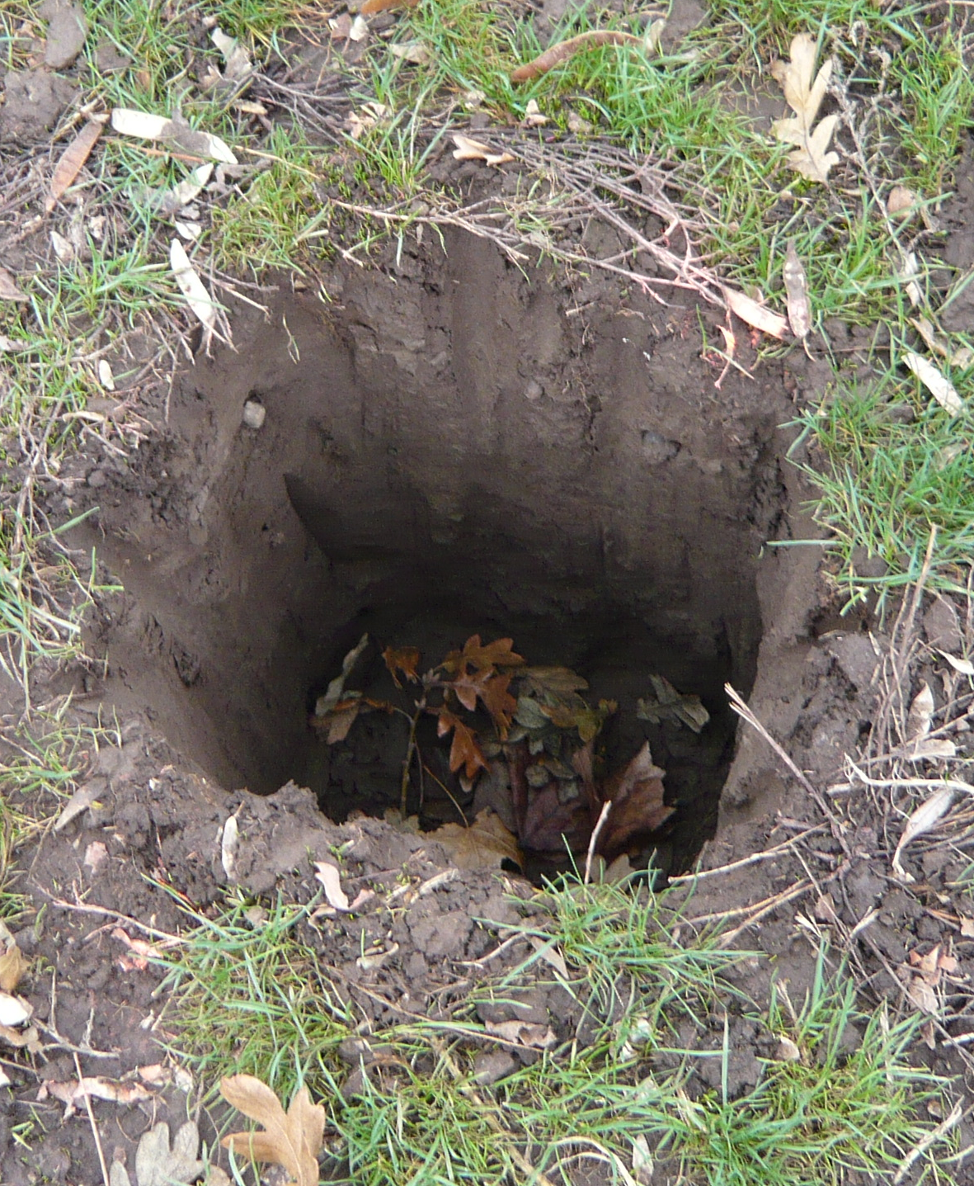
What Are Holes?
How much dirt is there in a hole that is 3M deep and 1.5M square?
Hint: 1.5M x 1.5M x 3M = 6.75M³ Six and three quarters cubic metres
There is no dirt in the hole because holes are empty

Slide 10
Is Your Glass Half Full or Half Empty?
There are three half full glasses in a row with three empty glasses arranged after them.
What is the minimum number of glasses you need to move to alternate the half-full and empty glasses?
Only one glass needs to be moved
Pick up the second glass and empty it into the fifth glass and put it back

Slide 11
Apples and Pears
There are three boxes of fruit
One contains apples, one has pears and the last has mixed apples and pears
Unfortunately all are labelled incorrectly.
You are not allowed to look into any box but you can ask a friend to take out one item from one box.
How do you know which box has which fruit?
Ask the friend to take out one fruit from the box labelled Apples and Pears which is the wrong label
If it is an apple then this box has apples.
So the box marked Apples must have Pears because the box marked Pears is wrongly marked and must have mixed apples and pears.
Similarly if the friend takes out a pear.

Slide 12
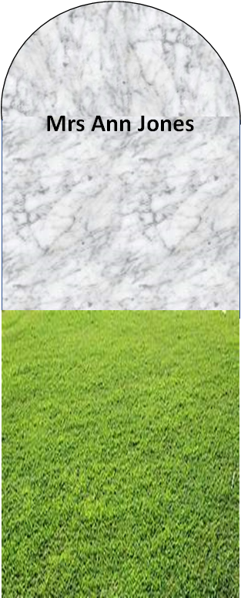
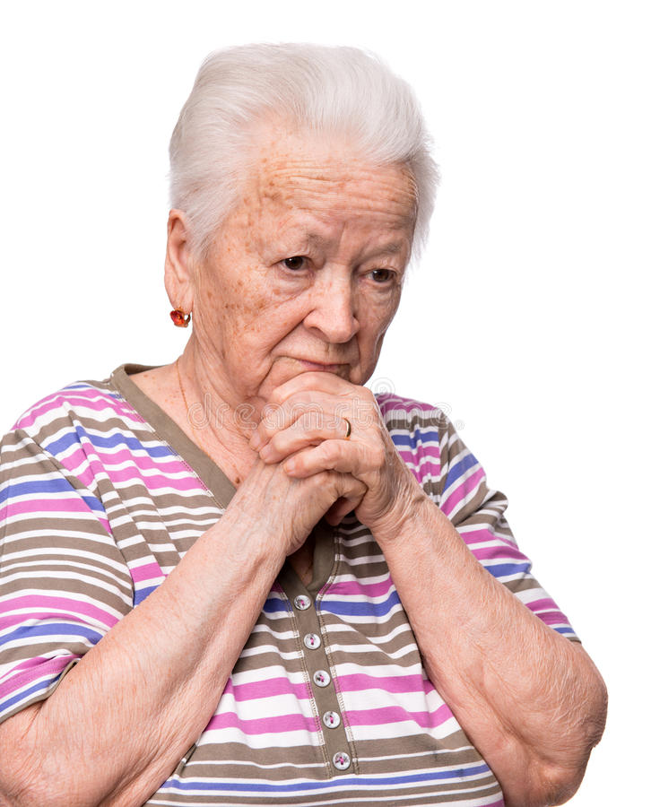
Marriage and The Law
Is it legal for a woman to marry her widower’s twin brother?
It is nothing to do with the law.
It is just impossible.
If her husband is a widower then she is no longer alive.

Slide 13
Thank You

