Slide 1
Welcome
These challenges were developed by Derrick Willer MBE and colleagues.
They are free to download and use in an education environment.
Please ensure that there is adult supervision, complete adherence to Health and Safety, and adequate PPE.
Derrick is a STEM Ambassador and volunteer Liaison Officer for Schools.
He has supported education in schools and colleges for over 30 years, initially as a Neighbourhood Engineer in the 1980’s, leading the local Year of Engineering Success campaign in 1996 and the Campaign to Promote Engineering from 1997 to 2004.
He was awarded an MBE for services to Education in 2018.

Slide 2
Guide
This activity is for pupils to discover the reasons for lagging their house to sae energy
The project uses 3V lamps and batteries with thermometers.
The pupils make a house from A4 paper and try to heat is using the bulbs, measuring the temperature rise after ten minutes.
They then lag the walls, ceilings and floor with bubble wrap and find that the temperature increases more.
Mandatory close supervision by a competent adult
Risks
Item | Risk | Avoidance Action
Scissors | Injury | Close supervision
Glue | Spillage Injury | Close supervision, sponge and water. If glue is ingested rinse mouth with water and give water to drink.
Batteries | Injury | Close supervision, Ensure they are not shorted out creating heat and fire
Bulbs | Injury | Close supervision. Clean up broken glass
Aggression between those present | Injury | Close supervision and immediate action to defuse aggression

Slide 3
Welcome
I very much hope that you will enjoy this activity as well as learning about lagging your house to save energy

Slide 4
Heat Conservation
Why Lag Your House?

Slide 5
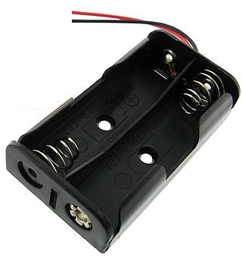
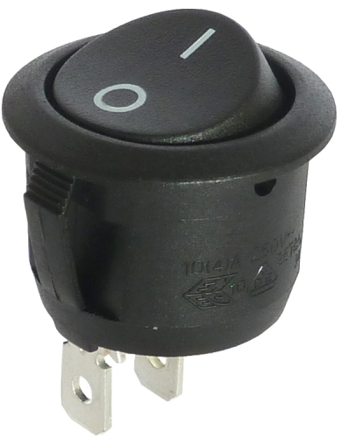
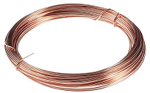
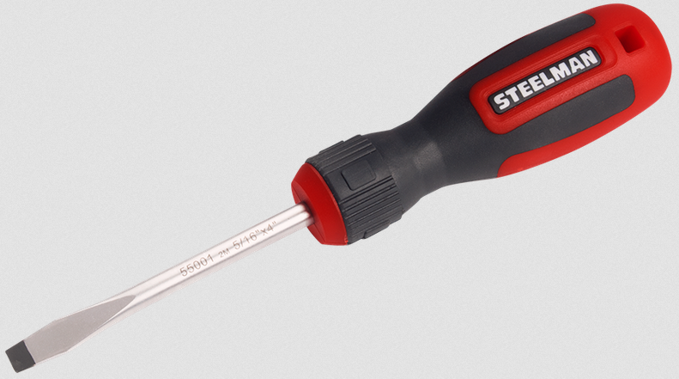
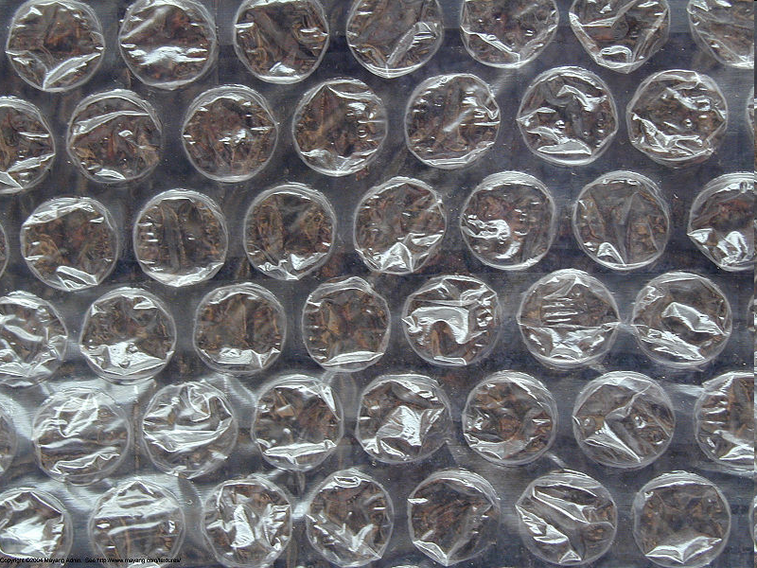
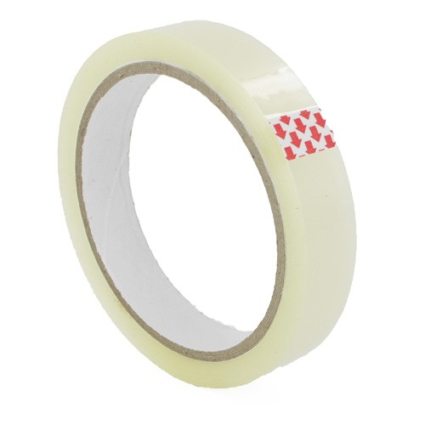
Heat Conservation
What you need:
Two 1.5V Batteries
Battery Holder
Switch
Three Lamp Holders
Three 3V Bulbs
Wire
Three Terminal Blocks
Screwdriver
Scissors
Paper
Bubblewrap
Clingfilm (optional)
Sticky Tape
A4 Paper
Please ensure the batteries are kept separately to avoid short-circuiting

Slide 6
Heat Conservation
Batteries
Always supervise
If the batteries are short-circuited they will get very hot and may catch fire
Tell children not to connect the batteries without supervision

Slide 7
Heat Conservation
How Effective Is Lagging Your House?
An exercise to show how household bills can be reduced by proper lagging.

Slide 8
The Circuit
Wire the Circuit Like This
Batteries
Screwdriver
Bulb
Switch
Bulb
Holder
Battery
Holder
Terminal Blocks
DO NOT Switch On Until the Teacher Has Checked Your Circuit
Danger From Overheating Batteries if
Short Circuited

Slide 9
Heat Conservation
Build A House Without Lagging
Cut out each side, base and roof of your house
Optionally, Cut out each Window and Door,
Use Clingfilm to represent Glass (Put Clingfilm on before you glue the parts together)
Put the lamp into the house with wires coming out to the battery pack
Insert the thermometer where you can read it
Glue the base, sides and roof together

Slide 10
Heat Conservation
Build A House Without Lagging
Cut out each side, base and roof of your house

Slide 11
Heat Conservation
Build A House Without Lagging
Cut out each Window and Door,
Use Clingfilm to represent Glass
Teachers can print the templates at the end of the slide-show
Teachers may need to pierce the windows so pupils can cut out with blunt scissors
Base

Slide 12
Heat Conservation
Build A House Without Lagging
Put the lamp in the base with wires coming out to the Switch and Battery Pack
Roof
Put the Thermometer on the base
so you can see it through a window
Base

Slide 13
Heat Conservation
Build A House Without Lagging
Build the House
Glue the flaps to the roof, sides and base Insert the Thermometer
Take a Thermometer Reading - go for a 10 minute break

Slide 14
Heat Conservation
Build A House Without Lagging
Take and Record a Thermometer Reading Turn on the Light Go for a 10 minute break
Put Batteries In

Slide 15
Heat Conservation
Build A House Without Lagging
After 10 Minutes
Take and Record a Thermometer Reading
Turn Off the Light
Write down how much the temperature has changed

Slide 16
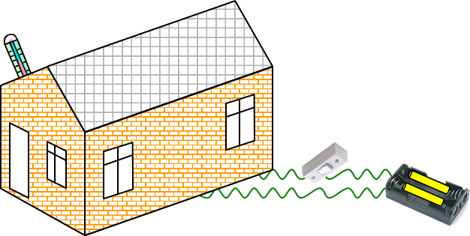
Heat Conservation
Build A House With Lagging
Now Stick Bubble-Wrap Inside Each Wall And Roof.
Also Put The House Onto A Layer Of Bubble Wrap.
Or you may just be measuring the temperature of the table.

Slide 17
Heat Conservation
Build A House With Lagging
Take and Record a Thermometer Reading Turn on the Light Go for a 10 minute break

Slide 18
Heat Conservation
Build A House With Lagging
After 10 Minutes
Take and Record a Thermometer Reading
Write down how much the temperature has changed

Slide 19
Heat Conservation
Build A House With Lagging
You Should Find That The House Insulated With Bubble Wrap Has Risen To A Higher Temperature

Slide 20
Heat Conservation
What are Your Conclusions?

Slide 21
Heat Conservation
Further Work Can you calculate how much energy saving you could make? Use the internet to find some answers!

Slide 22
Heat Conservation
Use the internet to find some answers! Search - saving energy in your home
http://www.propertypal.com/property-news/saving-energy-in-your-home
http://www.energysavingtrust.org.uk/ www.direct.gov.uk/en/Environmentandgreenerliving/Energyandwatersaving/Energyandwaterefficiencyinyourhome

Slide 23
Thank You

Slide 25
Cut Along Full Blue Lines
Cut out Windows & Doors and Stick Clingfilm to Represent Glass
Fold Along Dotted Blue Lines
Fold & Stick Roof Here
Fold – DO NOT Stick To Base

Slide 26
Cut Along Full Blue Lines
Cut out Windows & Doors and Stick Clingfilm to Represent Glass
Fold Along Dotted Blue Lines
Fold & Stick Roof Here
Fold – DO NOT Stick To Base

Slide 27
Fold and Stick To Roof
Fold and Stick To Roof
Cut Along Full Blue Lines
Fold Along Dotted Blue Lines
Cut out Windows & Doors and Stick Clingfilm to Represent Glass
Fold and Stick To Side
Fold and Stick To Side

Slide 28
Fold and Stick To Roof
Fold and Stick To Roof
Cut Along Full Blue Lines
Fold Along Dotted Blue Lines
Cut out Windows & Doors and Stick Clingfilm to Represent Glass
Fold and Stick To Side
Fold and Stick To Side

Slide 29
Roof

Slide 30
Bubble Wrap Size for House Sides - Cut Two

Slide 31
Bubble Wrap Size for House Front and Rear Cut Two

Slide 32
Bubble Wrap Size for House Roof - Cut One

Slide 33
Cut Along Full Blue Lines
Cut out Windows & Doors and Stick Clingfilm to Represent Glass
Fold Along Dotted Blue Lines
Fold & Stick Roof Here
Colour In Yourself
Fold – DO NOT Stick To Base

Slide 34
Cut Along Full Blue Lines
Cut out Windows & Doors and Stick Clingfilm to Represent Glass
Fold Along Dotted Blue Lines
Fold & Stick Roof Here
Colour In Yourself
Fold – DO NOT Stick To Base

Slide 35
Colour In Yourself
Fold and Stick To Roof
Fold and Stick To Roof
Cut Along Full Blue Lines
Fold Along Dotted Blue Lines
Cut out Windows & Doors and Stick Clingfilm to Represent Glass
Fold and Stick To Side
Fold and Stick To Side

Slide 36
Fold and Stick To Roof
Fold and Stick To Roof
Cut Along Full Blue Lines
Fold Along Dotted Blue Lines
Cut out Windows & Doors and Stick Clingfilm to Represent Glass
Fold and Stick To Side
Fold and Stick To Side

Slide 37
Roof
Colour In Yourself

