Slide 1

Welcome
These challenges were developed by Derrick Willer MBE and colleagues.
They are free to download and use in an education environment.
Please ensure that there is adult supervision, complete adherence to Health and Safety, and adequate PPE.
Derrick is a volunteer STEM Ambassador and leads the new Schools Liaison Community.
He has supported education in schools and colleges for over 40 years, initially as a Neighbourhood Engineer in the 1980’s, leading the local Year of Engineering Success campaign in 1996 and the Campaign to Promote Engineering from 1997 to 2004.
He was awarded an MBE for services to Education in 2018.

Slide 2
Guide
This activity is for pupils to understand the sun
Risks
Mandatory close supervision by a competent adult
Item | Risk | Avoidance Action
Tools | Injury | Close supervision
Eyes | Sight | Never look at the sun. Wear special glasses at all times if trying to look at the sun
Aggression between pupils | Injury | Close supervision and immediate action to defuse aggression

Slide 3
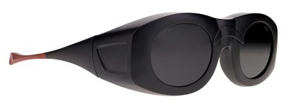
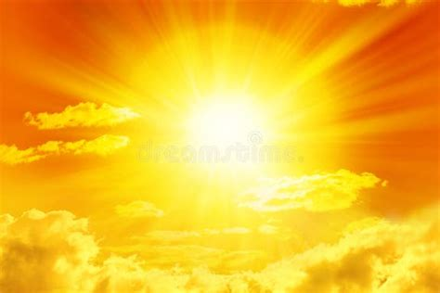
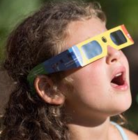
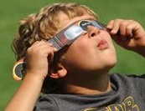
WARNING
Never look directly at the sun
without special glasses or a filter !!!!

Slide 4
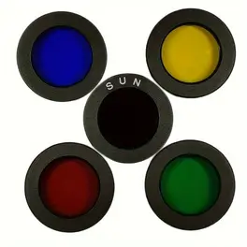
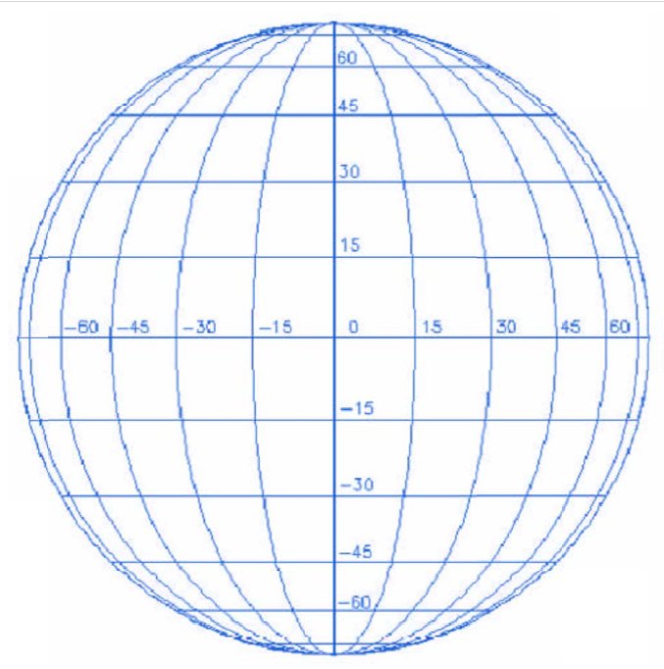
What you need
Safety Glasses For Looking At The Sun
(e.g. Solar Eclipse Glasses or Filter)
Telescope Filter
Spherical Mapping Grid

Slide 6
The Sun
We are going to look at the following aspects of the Sun
Sun Spots
Solar Flares
Solar Prominences
Why does the sun “burn”

Slide 7
What are Sun Spots?
Sunspots are dark, usually planet-size regions of strong magnetic fields on the surface of the sun. They can spawn eruptive disturbances such as solar flares and coronal mass ejections (CMEs).
These regions of the sun appear darker because they are cooler than their surroundings. The central dark region, the umbra, is about 6,300 degrees Fahrenheit (3,500 degrees Celsius), whereas the surrounding photosphere is about 10,000 F (5,500 C), according to the National Weather Service (NWS).
The frequency and intensity of sunspots visible on the surface indicate the level of solar activity during the 11-year solar cycle that is driven by the sun's magnetic field. Sunspots are our window into the sun's complicated magnetic interior, and they have fascinated solar observers for hundreds of years.

Slide 8
Current Sun Spot Cycle
11-year solar cycle

Slide 9
Lets Track Sun Spots
At the same time each day look at the sun safely and record the Sun Spots on the Mapping Grid
Near the equator there are just 12 recordings so the equator rotates about every 24 days (actually 25⅓ days)
Near the poles you have counted 16 so the poles rotate about every 32 days (actually 33.4 days)
cv
cv
cv

Slide 10
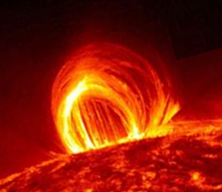
Solar Flares
A solar flare is a relatively intense, localized emission of electromagnetic radiation in the Sun's atmosphere.
Solar flares occur when stored magnetic energy in the Sun's atmosphere accelerates charged particles in the surrounding plasma.
Associated with solar flares are flare sprays. These involve faster ejections of material than eruptive prominences, and can reach velocities of 20 to 2000 kilometers per second.
Plasma is an electrically charge gas

Slide 11
Solar Flares
The radiation emitted during a solar flare shoots away from the Sun at the speed of light with high intensity.
This ionizing radiation, namely X-ray and extreme ultraviolet radiation, affects the Earth and astronauts in space.
The radiation has cause severe electricity blackouts as the one did in 2023 in northern USA and Canada.

Slide 12
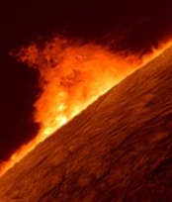
Solar Prominences
A solar prominence, sometimes referred to as a filament, is a large plasma and magnetic field.
Prominences are anchored to the Sun's surface in the much brighter photosphere, and extend outwards into the solar corona.
Photosphere is the outer layer of the sun.
While the corona consists of extremely hot plasma, prominences contain much cooler plasma, similar in composition to that of the chromosphere.
Chromosphere is the layer just below the Photosphere.

Slide 13
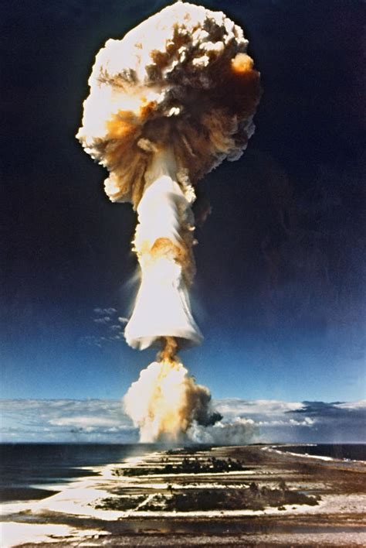
Why does the sun “burn”
The sun is a continuously running hydrogen bomb.
The central mass of the Sun is so hot and dense that it initiates nuclear fusion in its core.
Every second, the Sun's core fuses about 600 billion kilograms of hydrogen into helium and converts 4 billion kg of matter into energy.
First hydrogen bomb explosion
Fortunately, there is sufficient hydrogen to keep the sun shining for at lease 4 billion years.

Slide 14
How does the Sun’s hydrogen bomb work
The hydrogen atoms are moving at an enormous speed.
This causes them ionise meaning the protons are separated from their electrons.
Two protons then collide and become one deuterium atom (known as heavy hydrogen) which has one proton, one positron (opposite to an electron) and a neutrino.
A proton and a deuterium atom then combine to form a helium-3 atom (two protons with one neutron) and a gamma ray.
Two helium-3 atoms combine to form one helium-4 atom (two protons and two neutrons) and two protons.
Two helium-4 atom has less mass than the original hydrogen atoms used to form them
and difference appears as energy.

Slide 15
We have learnt about
Sun Spots
Solar Flares
Solar Prominences
Why does the sun “burn”

Slide 16

Well Done

